Slide 1

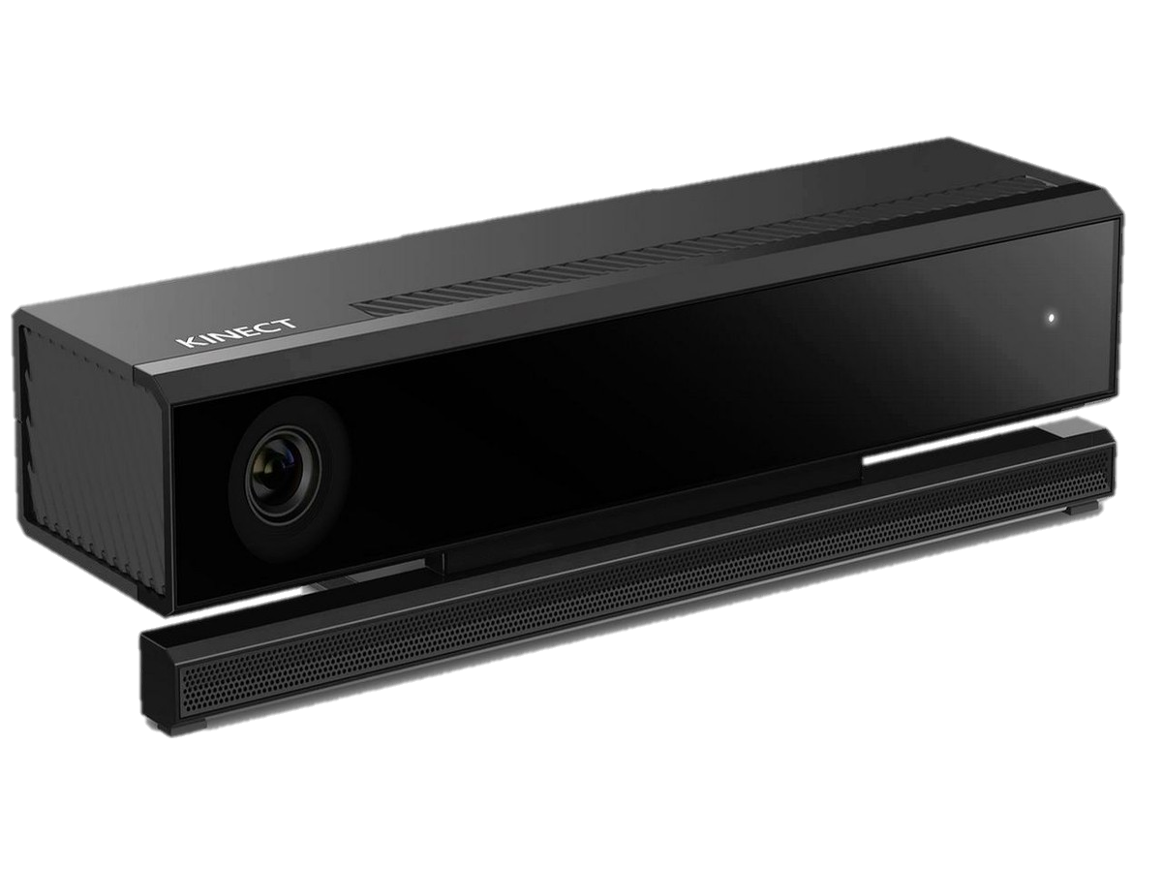
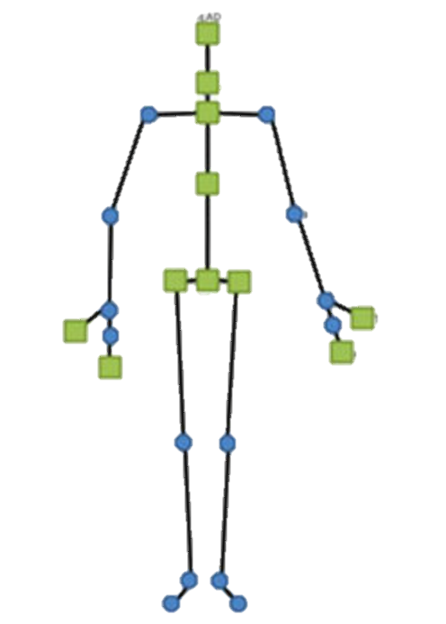
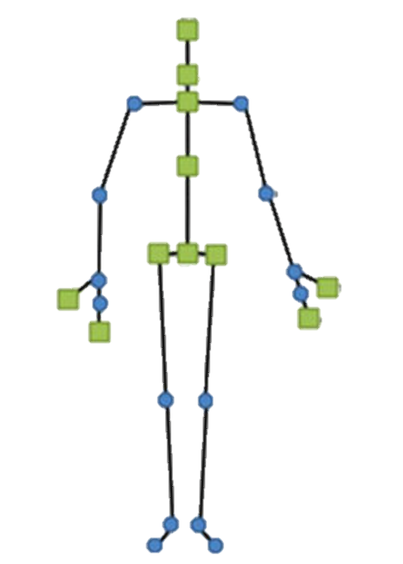

Kinect Block Diagram
Obtain joint of interest
Capture Local Timestamp
Send to Signal Correction Unit
3D position
Posture estimation
Compute Sagittal and Flex angle
Completed
Requires Refinement
Vicon
Send to Feedback Display
Not yet Implemented

Slide 2
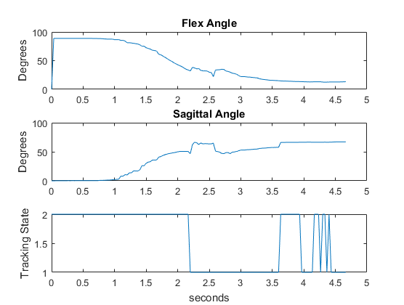
Test – Flexion of Body at 30 Degrees
2 – Tracked
1 - Inferred

Slide 3

Render Initial View
Standby
Tracked Body?
No
Feedback Display Flowchart
Yes
Visual Gesture Builder
Compute Sagittal & Flex Angle
Gesture Database
Kinect Studio
Recorded Clips
Error?
No
Update Message
Parse Error Code
Completed
Requires Refinement
Update Error Message
Go back to standby
Not yet Implemented

Slide 4
